Slide 1
A cloud-fog based architecture for iot applications dedicated to healthcare
authors: Randa M.Abdelmoneem, Abderrahim Benslimane† , Eman Shaaban , Sherin Abdelhamid and Salma Ghoneim(ICCC)
journel: International Carpathian Control Conference (ICCC)

Slide 2
objective
The main objective of this project is to develop a comprehensive IoT-Fog-Cloud architecture for real-time healthcare monitoring. The system is designed to provide efficient and reliable data processing, prioritizing a low latency response for critical tasks.

Slide 3
Layers:
IoT Devices: Sensors collecting patient data in real-time.
Sink Layer: Gateways aggregating and filtering data.
Fog Layer: Real-time processing, emergency detection, WSM + MBAR algorithms.
Cloud Layer: Long-term storage, analytics, historical insights.

Slide 4
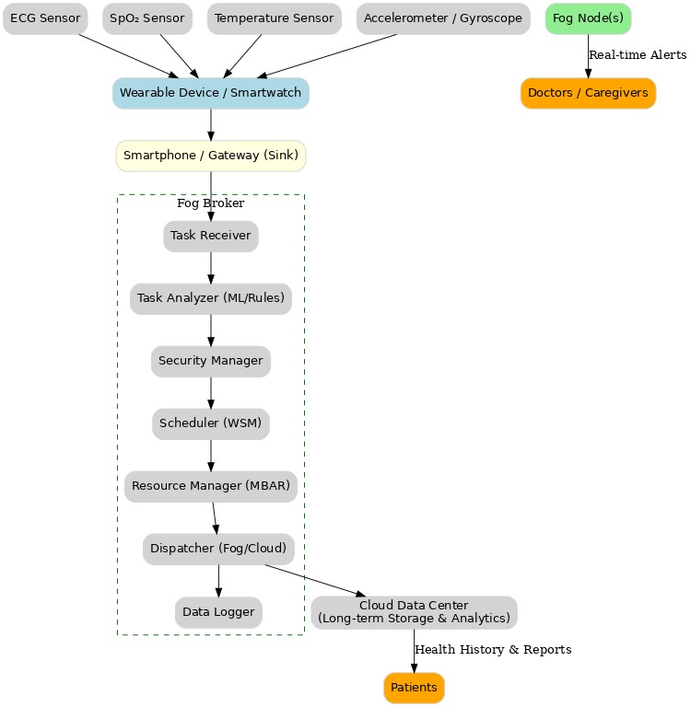
Revised Architecture diagram

Slide 5
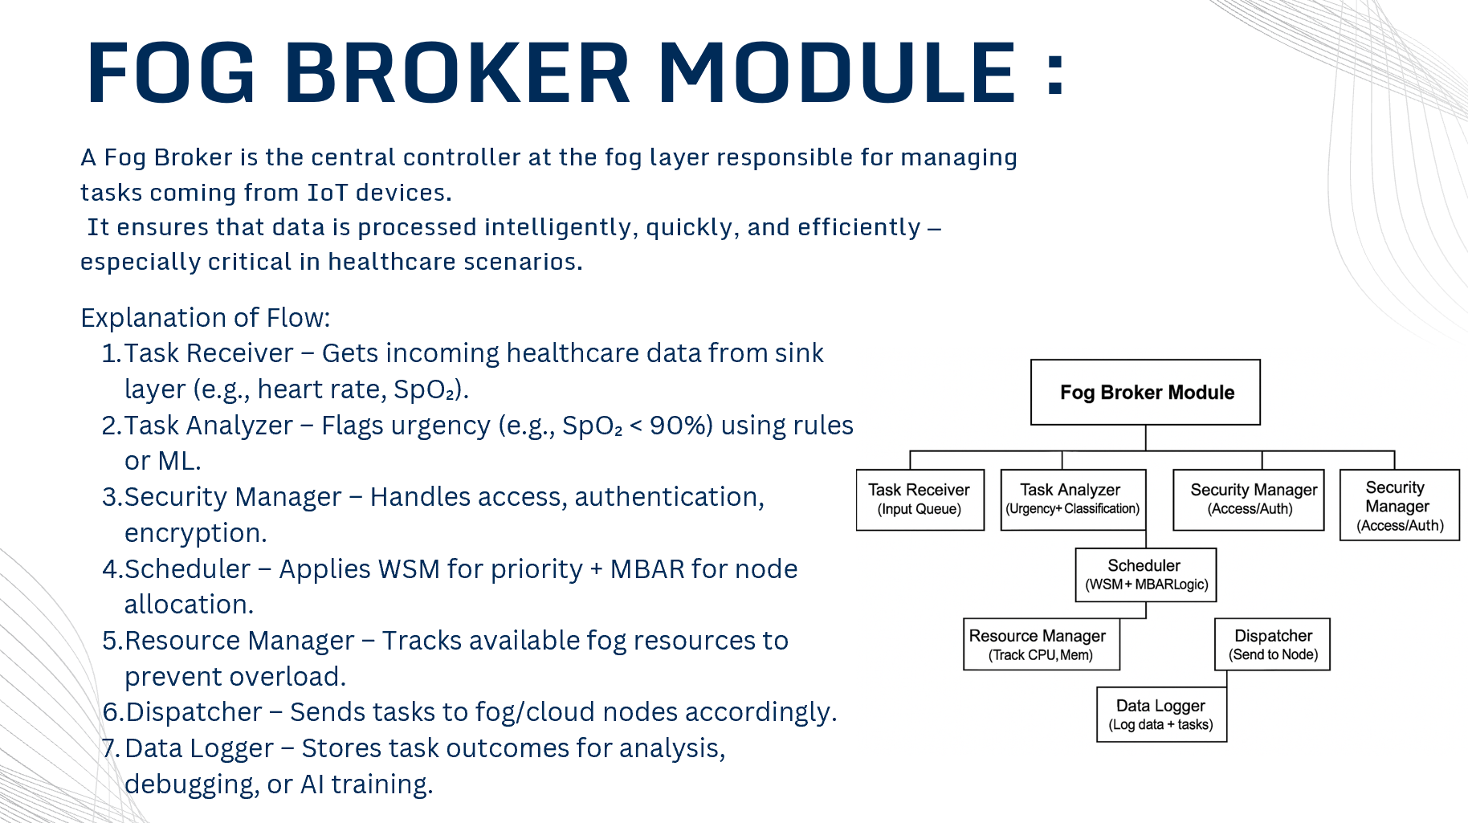

Slide 6
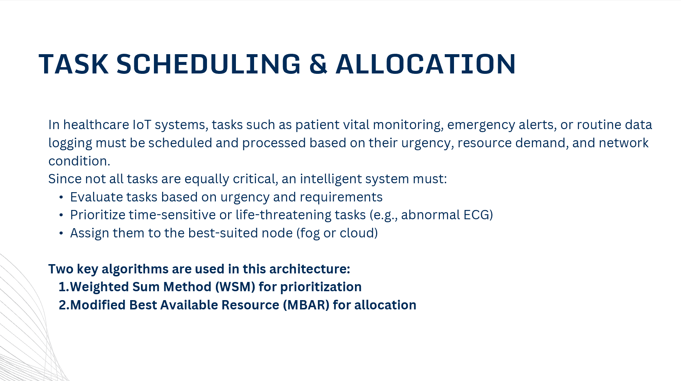

Slide 7
Algorithm Implementation:
We have added and implemented pseudo-code for the WSM (Weighted Sum Method) and MBAR (Multi-objective Bayesian Reinforcement Learning) algorithms.These algorithms are critical for enabling efficient task scheduling and resource allocation within the Fog Layer.

Slide 8
Simulation Plan (expanded): Specified simulator options , 20 tasks, and scenarios to compare
(Random vs WSM+MBAR). Metrics: Latency, Miss Ratio, Average Delay, Cost/Execution, Resource Utilization.
Edge Code Implementation (Python snippet):
Added a concise WSM (priority formula) and MBAR allocation example in Python for quick demo in the presentation.
GitHub Contributions (proof slide):
Each member’s contribution listed and placeholder for commit screenshots / links.

Slide 9
Metrics to Evaluate:
We will measure the following to assess our system's efficiency and reliability:
Latency: To ensure real-time response for critical tasks.
Miss Ratio: To track the percentage of tasks that fail to meet their deadlines.
Resource Utilization: To evaluate the efficiency of our resource management.
Cost per Execution: To analyze the overall cost-effectiveness of our approach.

Slide 10
Enhancements & Key Contributions
Improved Architecture Clarity – Refined diagram, clearer IoT → Sink → Fog → Cloud data flow.
Algorithm Implementation – Pseudo-code for WSM & MBAR integrated at Fog layer.
Expanded Simulation Plan – Added Latency, Miss Ratio, Resource Utilization metrics.
Proof of Contribution – GitHub commits/screenshots from all members.

Slide 11
Thank you

